Slide 1
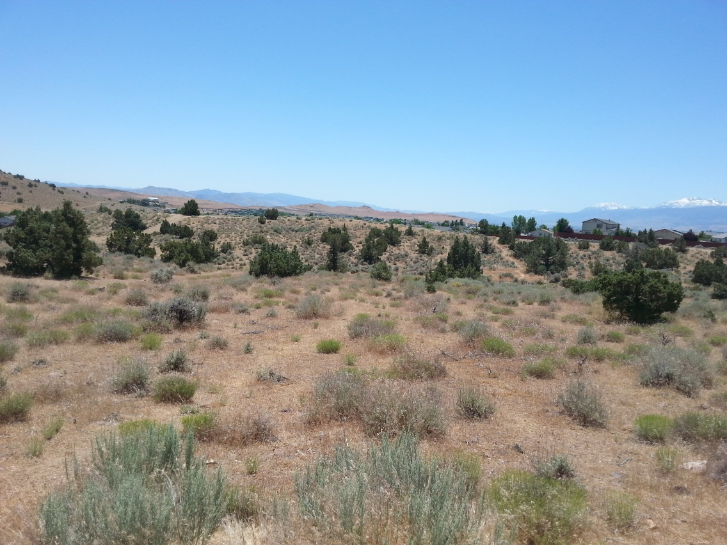
Washoe County Board of Adjustment
August 3, 2017
Special Use Permit Case Number WSUP17-0012
Sun Valley Middle School Grading

Slide 2
Case Description
Special Use Permit Case Number WSUP17-0012 (Sun Valley Middle School Grading) – For possible action, hearing, and discussion to approve major grading of an area of approximately 25.5 acres and excavation of approximately 175,000 cubic yards of earthen material to facilitate construction of a new Middle School. The grading requested and possible action to be taken also includes a request for a variance to allow the creation of slopes greater than ten feet in height.

Slide 3
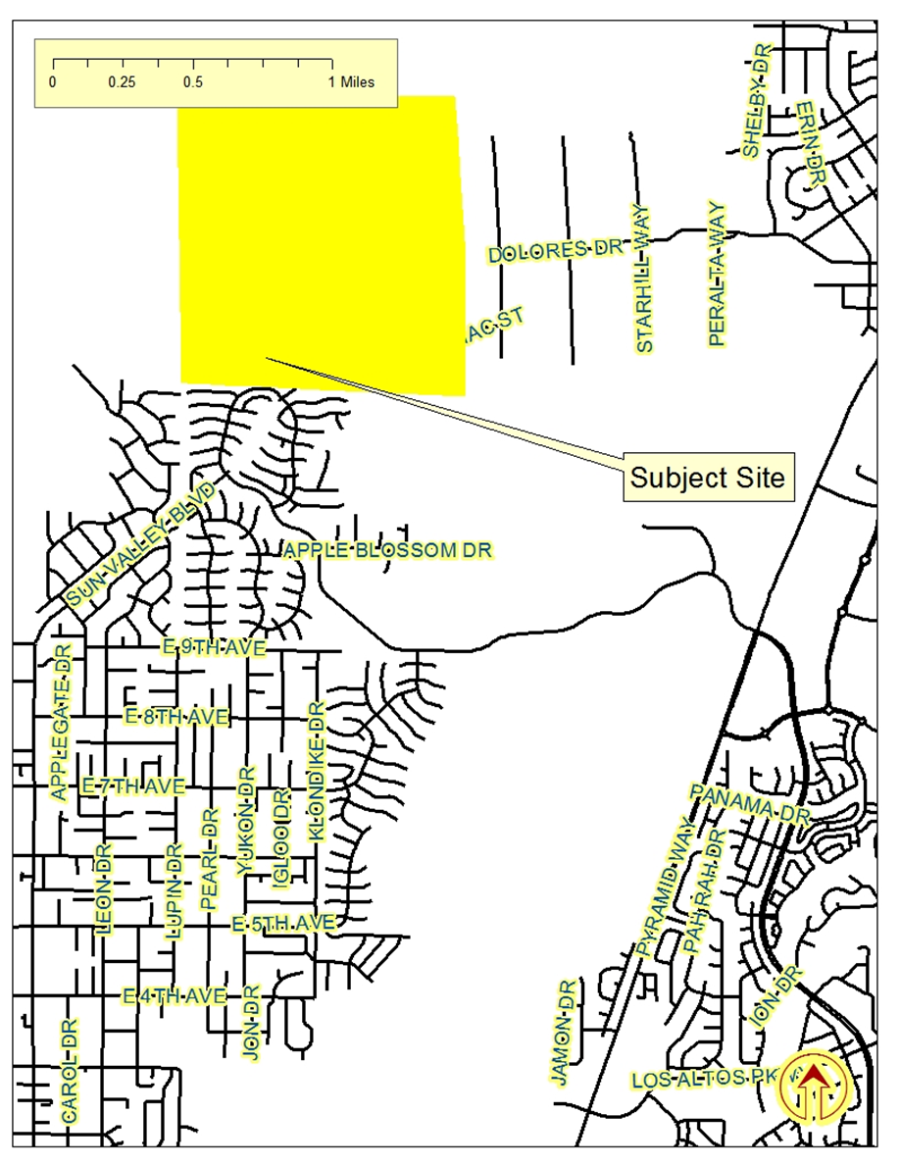
Vicinity
Map

Slide 4
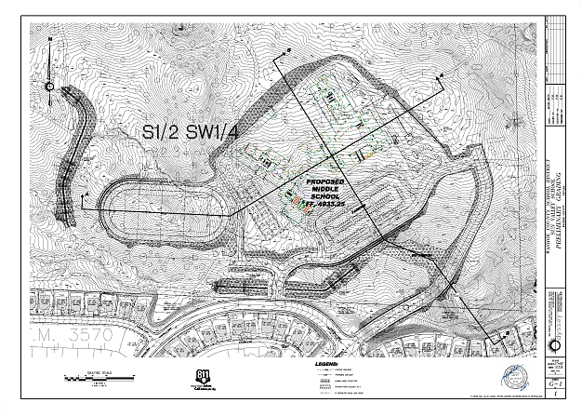
Site Plan
Site Plan

Slide 5
Site Plan
The site plan shown on page 5 of the staff report was distorted vertically, but not horizontally. This made the grading appear to be more extensive that it is in reality.
A correct site plan was included in the staff report at Exhibit E.
A correct site plan was emailed to each of the BOA members and paper copies were provided, prior to this hearing.

Slide 6
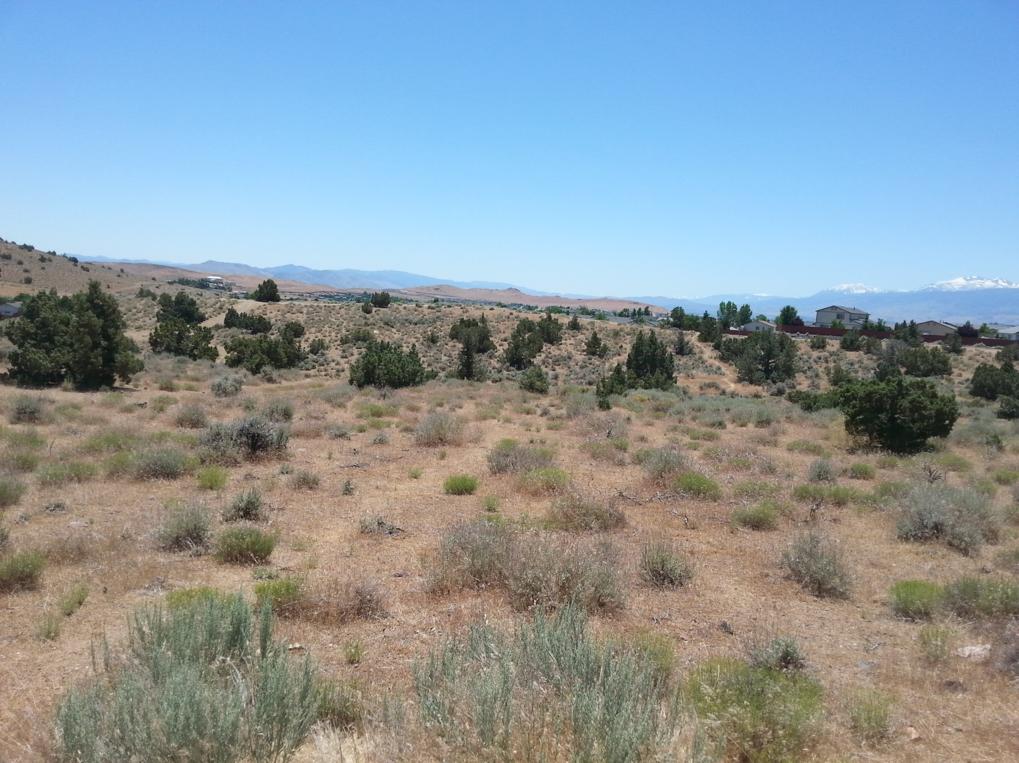
Current Photo of Subject Site

Slide 7
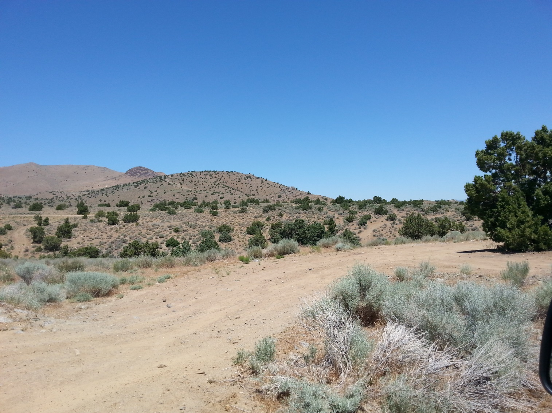
Current Photo of Subject Site

Slide 8
Background
The subject property has a regulatory zone of General Rural (GR). The proposed grading, an area of approximately 25.5 acres and excavation of approximately 175,000 cubic yards of earthen material to facilitate construction of a new middle school, is permitted in all regulatory zones with a Special Use Permit (SUP) in accordance with Washoe County Code (WCC) Section 110.438.35. Therefore, the applicant is seeking approval of this SUP from the Board of Adjustment.

Slide 9
Analysis
Public School are allowed without discretionary review (Article 440 of Development Code).
Meetings between the School District and Washoe County are Required.
During those meetings it was agreed that grading for a school exceeded the thresholds for “Major Grading” – a Special Use Permit is required.

Slide 10
Analysis
The School District has worked with County Staff and submitted modified plans that eliminated most concerns.
Conditions of Approval have been recommended to address identified impacts.
Cut slopes greater than 10 feet (generally the limit allowed by Article) are proposed and recommended for approval because they will be behind the proposed school.

Slide 11
Analysis
Natural vegetation and Juniper trees will be preserved as much as possible.
All disturbed areas not otherwise stabilized will be revegetated.
Construction hours are 7 a.m. to 7 p.m. during the week; between 9 a.m. and 7 p.m. on Saturday; and no grading activity is permitted on Sunday.

Slide 12
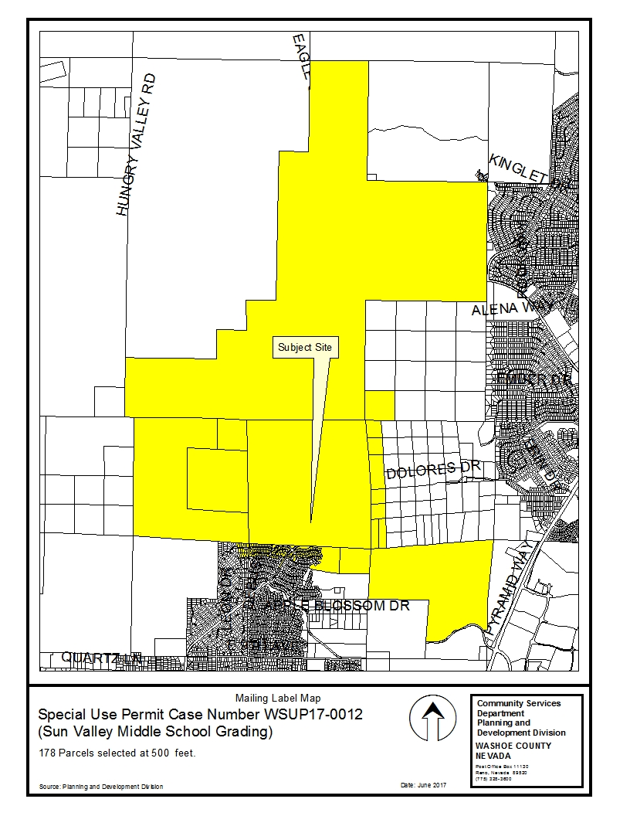
Public
Notice

Slide 13
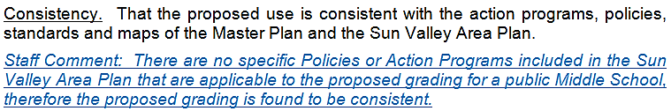
Special Use Permit Findings

Slide 14
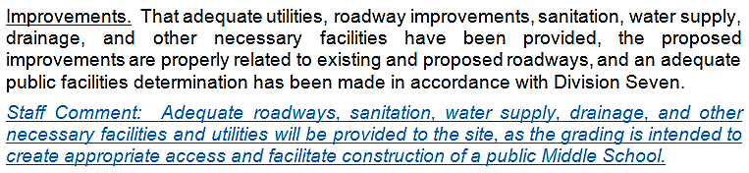
Special Use Permit Findings

Slide 15
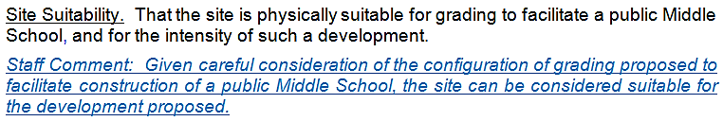
Special Use Permit Findings

Slide 16
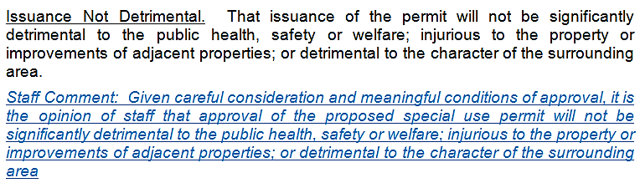
Special Use Permit Findings

Slide 17
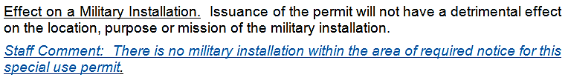
Special Use Permit Findings

Slide 18
Recommendation
Those agencies which reviewed the application recommended conditions in support of approval of the project or provided no comment. Therefore, after a thorough analysis and review, Special Use Permit Case Number WSUP17-0012 is being recommended for approval with conditions.

Slide 19
Possible Motion
I move that, after giving reasoned consideration to the information contained in the staff report and information received during the public hearing, the Washoe County Board of Adjustment approve with the conditions of approval included at Exhibit A to this matter, Special Use Permit Case Number WSUP17-0012 for the Washoe County School District, having made all five findings in accordance with Washoe County Code Section 110.810.30

Slide 20
Questions?

